Slide 1
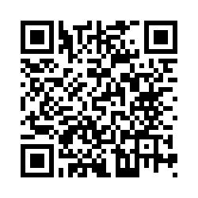

Views on cannabis-based medicines for anxiety in autistic people
Researchers at King’s College London are studying cannabis-based medicines for anxiety in autistic people. We would like to understand your views on these medicines, as well as other treatments for anxiety that you may have tried.
We are looking for autistic people aged 18 and above, who experience anxiety and live in England to take part in a 10-minute survey.
The survey will ask you questions about yourself (e.g., age, gender), anxiety symptoms and treatments you have tried, and your views on cannabis-based medicines and the design of a study to test these medicines.
To take part, please visit the following link: https://qualtrics.kcl.ac.uk/jfe/form/SV_0Gx0hUG0TJX06Y6 or scan the QR code:
For more information, please contact: jess.kerr-gaffney@kcl.ac.uk
V2.0 24.03.2025

